Slide 1
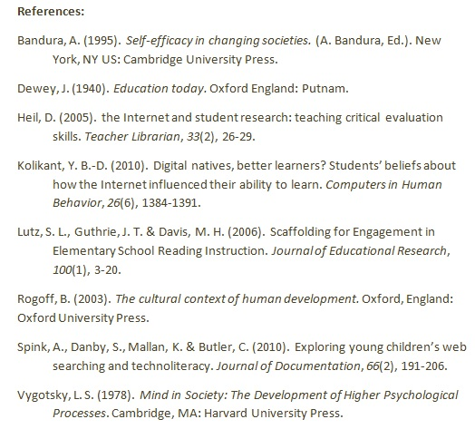
Important Theories
Data Analysis
Zone of Proximal Development: With support, students in the “zone of proximal development” can successfully engage in a learning task (Vygotsky, 1978).
Instructional scaffolding, such as modeling, thinking aloud, asking questions at critical junctures of instruction can provide the needed support to make Web-searching tasks accessible to students (Lutz, Guthrie, & M. H. Davis, 2006; Rogoff, 2003).
Scavenger Hunt Questions
Pre Assessment
  Who was the silversmith that made the midnight ride during the American Revolution?
  What was the name of the first colony in America?
  What 5 colonies made up the New England region?
  Who was born in Boston on January 17, 1706. He was an American printer, author, philosopher, diplomat, scientist, and inventor?
  Who was an English Quaker who spoke out on Civil War and religious freedom? He founded Pennsylvania, which he named after his father.
  What 4 colonies made up the Middle Colonies region?
  What 4 colonies made up the Southern Colonies region?
Post Assessment
  Who sewed the first American flag?
  How many people signed the Declaration of Independence?
  Who had the largest signature on the Declaration of Independence?
  When did the American Revolution start?
  Who was known as the Father of the Bill of Rights?
  Who wrote the book “Home Life in Colonial Days”?
  In what city was the first school in America located?
Constructivist Learning Theory: Teachers must acknowledge that students come into the classroom with interests and abilities that must be honored and built upon. Students construct knowledge so lessons must adapt to students’ learning background (Dewey, 1940).
Scavenger Hunt Outcomes
Social Cognitive Theory: Students with a high degree of self-efficacy with respect to a particular task or activity, will be able to engage in the task or activity, without being impeded by fear of failure or potential negative outcomes (Bandura, 1995).
Questions Correct
Web Searching Questions
Pre-questions (Time 1 - 1/6/2011):
  Which language do the inhabitants of the Island of Madagascar speak?
  Which take-and-back pizza restaurant was voted best in Chico by the Chico News and Review in 2008 and 2009?
  What are the names of President Obama’s daughters?
  Who is the author of the book The Good Earth?
  Who is the author of the book Closed for the Season?
  In what year did the French Indian War end?
Post- questions (Time 2 - 2/15/2011):
  What is the native language of Hungary?
  In what year was the Oroville Dam built?
  What are the first names of Vice-President Joe Biden’s three children?
  Who is the author of the book Wuthering Heights?
  Who is the author of the book Freak the Mighty?
  In what year was Shasta Dam completed?
Website Validity
Trustworthiness: A trait that can be referred to as deserving confidence and trust. Students must believe that they will gain trustworthy data when they search. Validating a source, or assessing the trustworthiness of a source was taught through:
      Assessing the URL (Uniform Resource Locator -web address such as www.csuchico.edu)
      Triangulation of a finding
      Seeking advice from a parent, teacher or other trusted source
Web Searching Outcomes
Rubric
Scored
Self – Efficacy Questions
Questions were asked on a five-point Likert scale ranging from strongly disagree to strongly agree. (1= strongly disagree to 5 = strongly agree)
  I believe I have the ability to find information I need on the Internet.
  I believe I have the ability to use effective search terms to find information on the Internet.
  I believe I have the ability to select the best search engine for my search tasks.
  I believe I have the ability to use logic modifiers for example (not, and, or) to refine my searches.
  I am confident I can find information I need on the Internet.
Self – Efficacy Outcomes
Ave.
of
Sum

